Slide 1
ANAlysis of football players in FIFA-19
DIGITAL TOOLS FOR​ STRATEGIC PLANNING (DOORSTEP)​
Advanced Systems Engineering Prof. Dr.-Ing. Roman Dumitrescu
Avinash Kumar, Vamsi Krishna, Vishwas Narayan​ MS Teams | July 7, 2021​

Slide 2
Presentation Outline
Analysis of Football Clubs
Analysis of positions and skillset of football players
Analysis of Strikers

Slide 3
Analysis of Football CLUBS
1

Slide 4
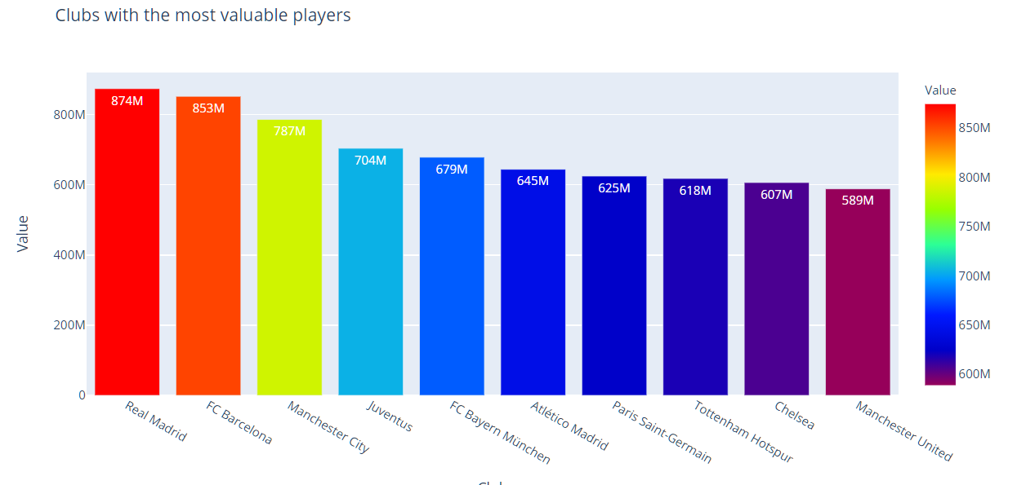
Most Valuable clubs in terms of market value of it’s players
Every player in fifa19 has a market value in which he can be bought by the other clubs.
The valuation of club is calculated by adding up the value of its players.
Real Madrid has some of the most valuable players like Luka Modrić, Toni Kross, Isco having market value of more than 50 Million Euros.
FC Barcelona comes second with their star player Messi having market value of 110 Million Euros.

Slide 5
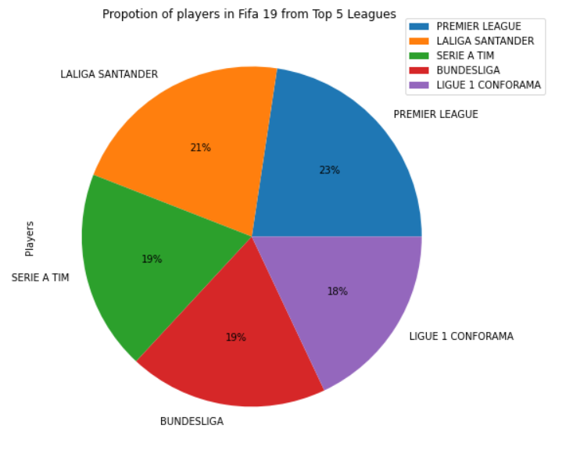
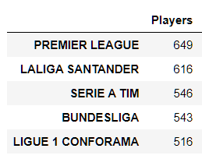
Top 5 Football Leagues
Countries have their own football league where different clubs play.
Major leagues come from European nations like England, Spain, Italy, Germany and France.
English Premier League is the most famous league with top clubs like Liverpool, Manchester United, Manchester city playing in Premier League.

Slide 6
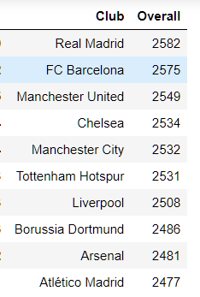
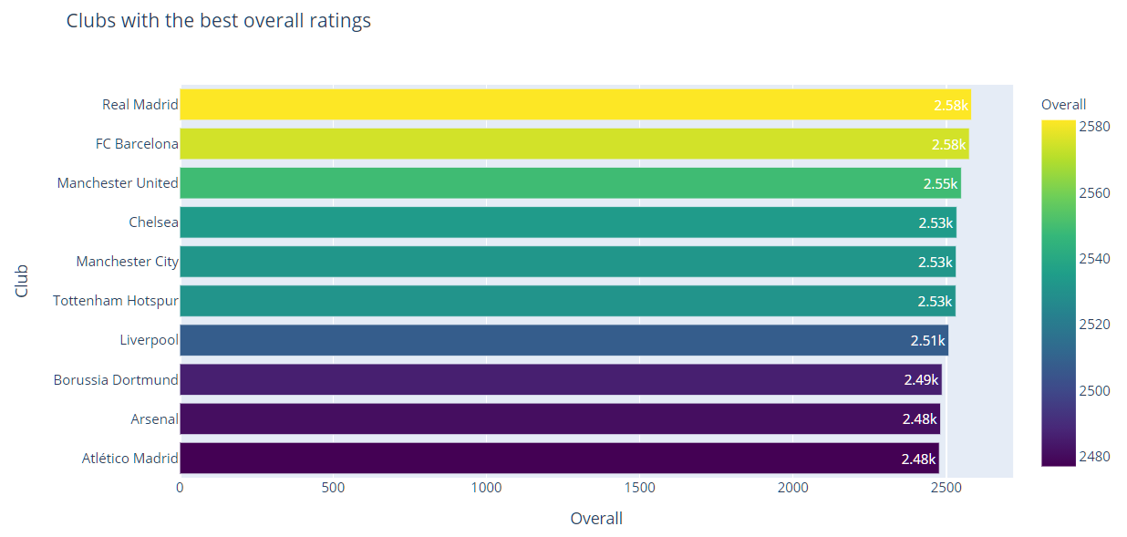
Top 10 clubs with best overall ratings
Real Madrid lead the chart with overall ratings of the entire club with 2582 followed by FC Barcelona and Manchester United.
Spanish clubs dominate over other clubs when it comes to overall ratings of players.

Slide 7
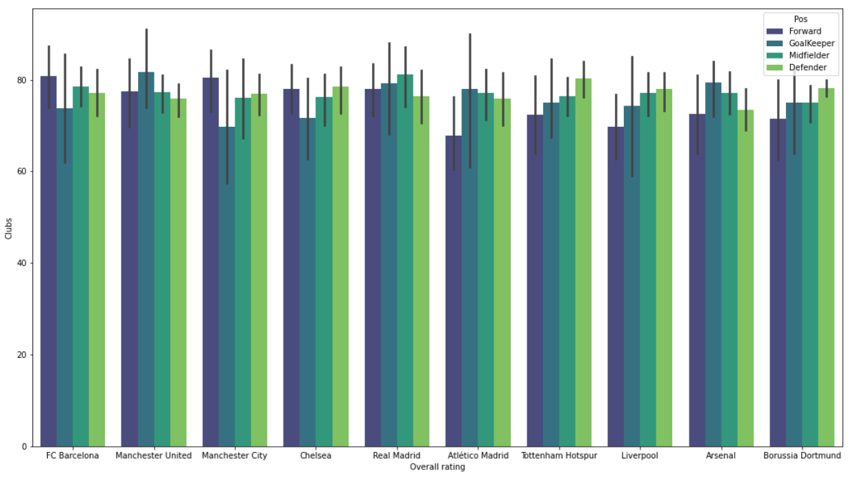
Contribution of Forwards, Defenders, Midfielders in Overall ratings of top 10 Clubs
Real is the most balanced team when it comes to overall ratings of it’s forwards, Midfielders, Defenders and Goalkeeper.
Tottenham Hotspur and Liverpool have better defenders than Real Madrid but Lacks in Forwards.
FC Barcelona, Machester City and Manchester United beats Real Madrid in Forwards and Goalkeeping positions but does not fare better when it comes to midfield.

Slide 8
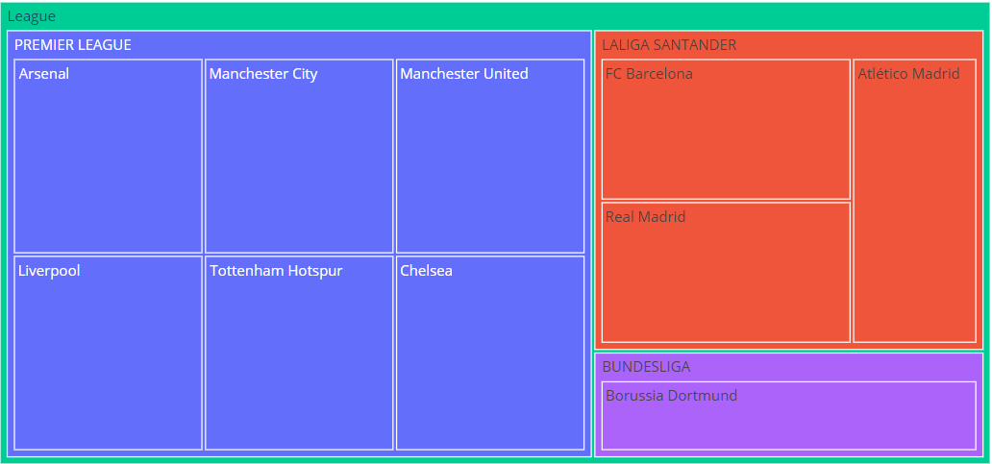
Grouping Top 10 clubs to their respective playing league
English Premier League has the maximum number of Top clubs.
Clubs from Spanish League LaLiga Santander acquire the top two places in fifa19.
German League Bundesliga has only club Borussia Dortmund from the Top 10 clubs.

Slide 9
Which Club will concede the fewest goals in Fifa19?

Slide 10
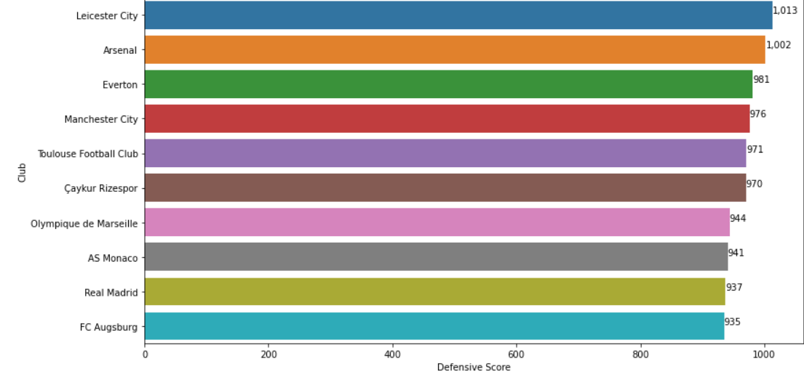
Defensive Score - Which Club will concede the fewest goals in Fifa19?
Players at defensive positions like LWB, LDM, CDM, RDM, RWB, LB, LCB, CB, RCB, RB, GK were considered.
Defensive skills of players like Interceptions, Positioning, Marking, StandingTackle, SlidingTackle, GKDiving, GKHandling, GKKicking were calculated.
Leicester city has the most prominent defensive score among all the clubs.

Slide 11

Most defensive Club in Fifa19
English club Leicester City has a very promising squad when it comes to defending themselves against other club’s attack.
Leicester City has total of 32 players in their squad and out of 32, 11 plays as defenders and 4 plays as defensive midfielder.
Harry Maguire is the best defender in Leicester having overall ratings of 82.

Slide 12


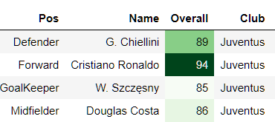
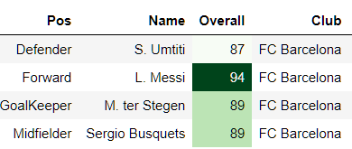
Club Analysis : Juventus Vs FC Barcelona
Juventus has total of 25 players.
9 Defenders, 9 Midfielders, 4 Forwards and 3 Goalkeepers.
Best Players:-
FC Barcelona has 33 players in their squad.
11 Defenders, 10 Midfielders, 8 Forwards and 4 Goalkeepers.
Best Players:-

Slide 13
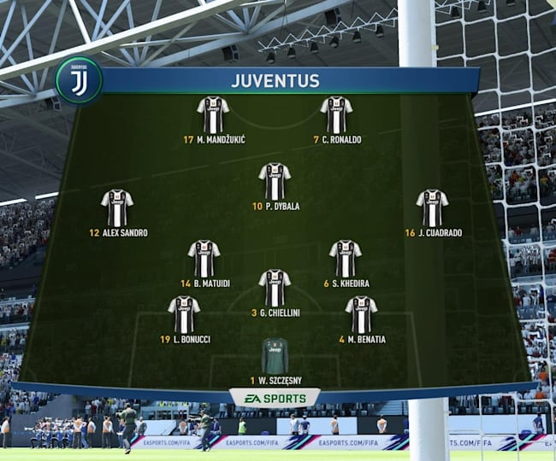
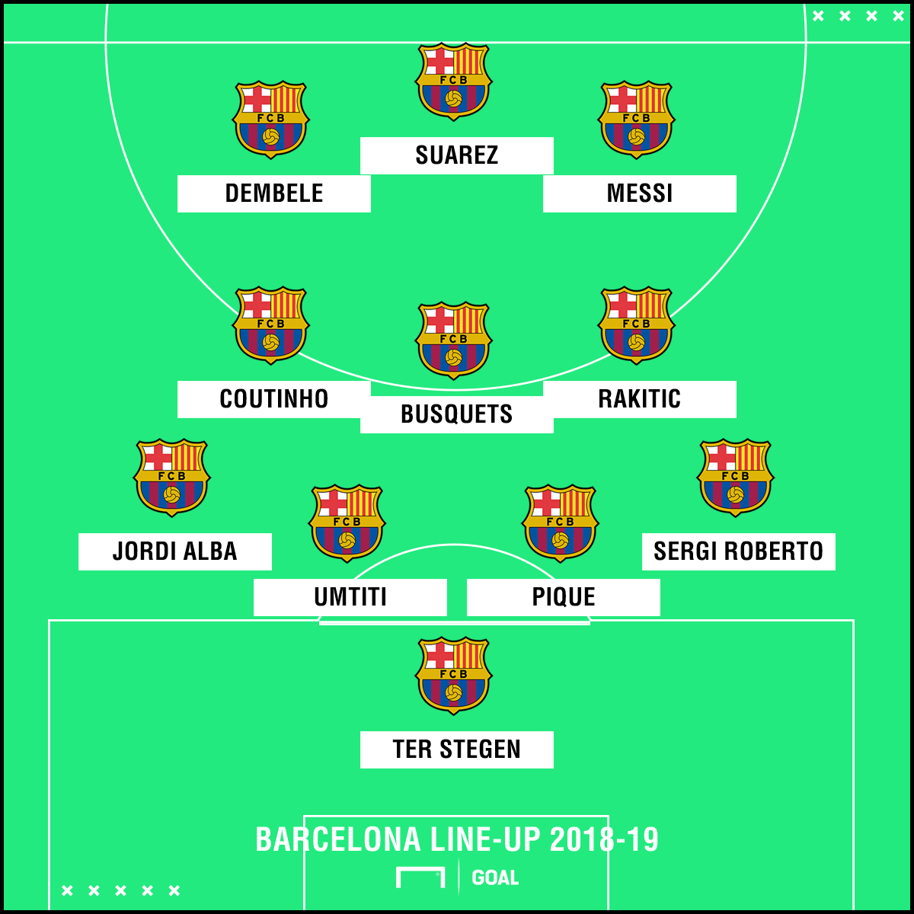
Playing Formation
Juventus 3-5-2 Formation
Barcelona 4-3-3 Formation
Juventus prefers defensive tactic with three central-backs and two defensive midfielders.
FC Barcelona has attacking mindset with two wingers, one striker and two attacking midfielders.
https://www.redbull.com/my-en/fifa-19-best-formation-guide
https://realsport101.com/fifa/fifa-19-barcelona-career-mode-guide-tactics-formations-tips/

Slide 14
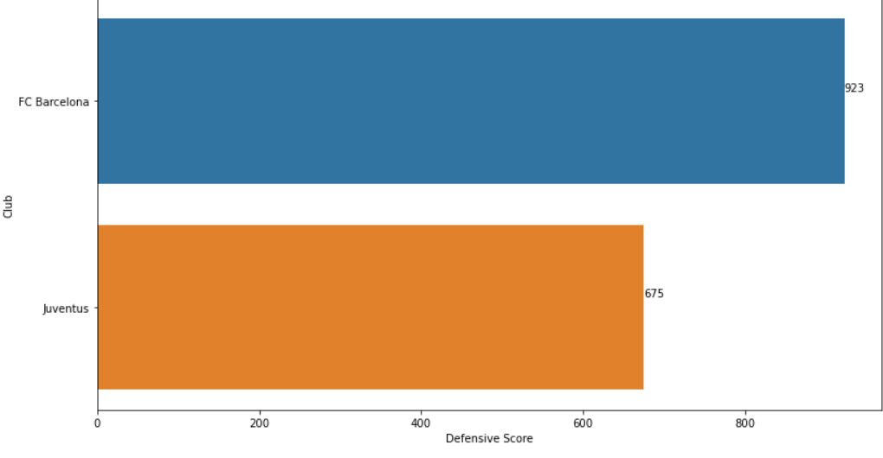
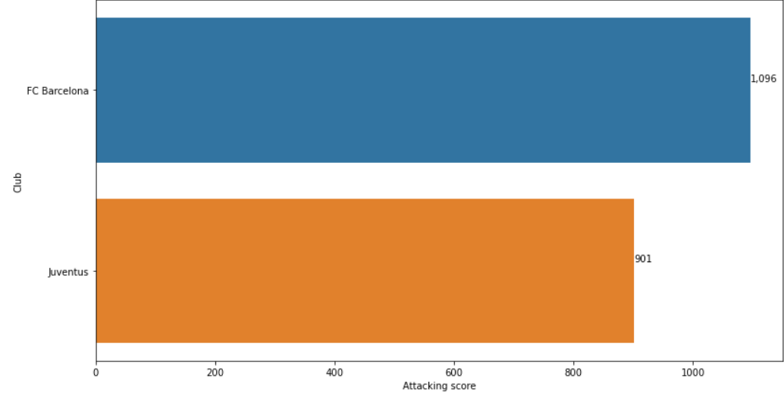
Attack and Defense Comparison
Defense
VS
Attack
It is evident from the two graphs that FC Barcelona dominate Juventus in attacking and well as defensive area.

Slide 15
Inferences and Conclusion of the analysis of the clubs
Real Madrid is most Valuable club in terms of market value of it’s players
Premier League has the maximum number of players among any other league.
Real Madrid is the highest overall rated club/ team in the game with an overall rating of 2582.
Most of the top clubs comes from Premier League.
Leicester City is the defensive club and most likely to concede fewest goals in fifa19.

Slide 16
Analysis of positions and skillset of football players
2

Slide 17
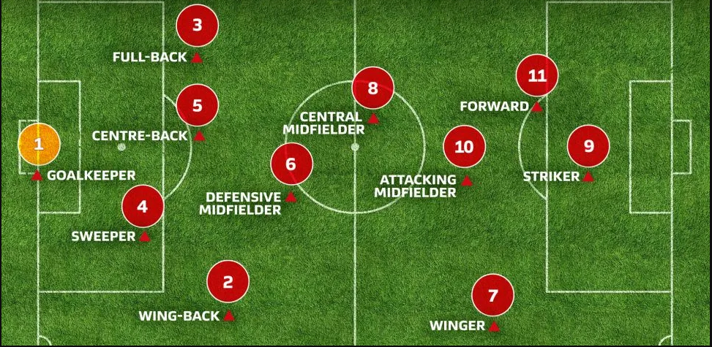
Overview of the positions(ST, CDM and GK) on the football field
Strikers: The role of a striker is to score goals. They possess great power and accuracy, and have the ability to link-up with teammates.
Centre Defensive Midfielders: The CDM’s role is divided roughly equally between attack and defense and to dominate the play around the center of the pitch.
Goal Keepers: It is one of the major positions of association football. The goalkeeper's primary role is to prevent the opposing team from scoring.

Slide 18
Data analysis approach to determine the differences of player’s position and skillset
Reading the dataset and understanding the correlation between different column fields in the dataset
Grouping the data based on ‘Positions’ by separating based on their ‘Zones’(Attack, Defense, Midfield, GK)
Horizontal Bar chart to visualize and determine the number of players based on their positions and zones
Data preparation by conversion into correct format for skillset and dealing with invalid data
Data filtering by selection of players who are Strikers, Centre Defensive Midfielders and Goalkeepers
Pie chart, Boxplot and Polar chart Visualizations for finding the similarities or differences between the chosen players

Slide 19
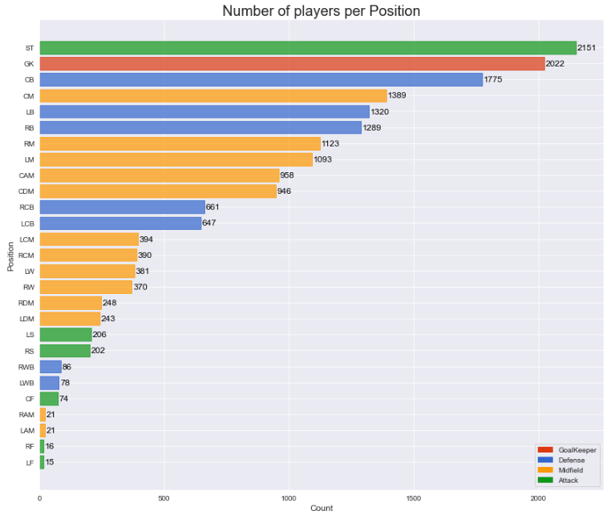
Horizontal Bar chart: Determination of the number of players per position
Horizontal Bar chart shows that the highest number of players per individual position are the Strikers followed by Goalkeepers and then centre back players.

Slide 20
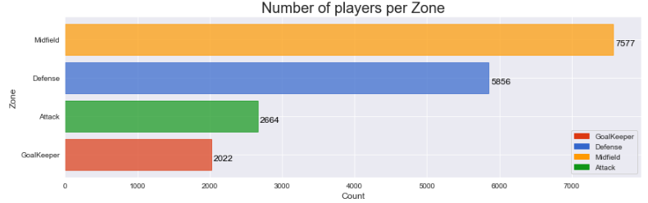
Horizontal Bar chart: Determination of the number of players per zone
Horizontal Bar chart shows that most of the players per individual zones are the Midfielders followed by Defensive players and then the Attackers.

Slide 21
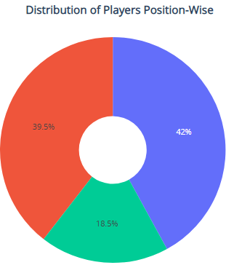
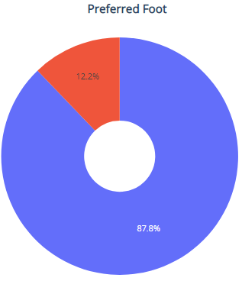
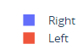
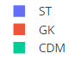
Pie chart Visualization: Determination of selected player distribution and preferred foot
Strikers (2151) followed by Goalkeeper (2022) and lastly the Centre defensive Midfielders(946)
There are more Right Footed (4495) players compared to Left Footed (624) players

Slide 22
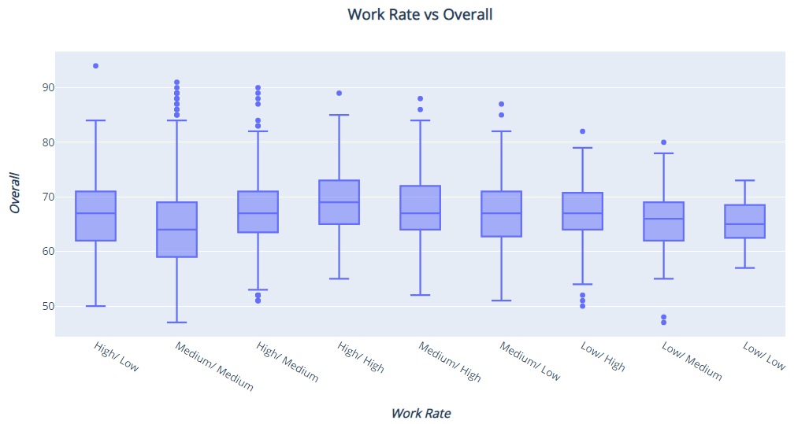
Boxplot Visualization: Work Rate vs Overall of the selected players
The below boxplot shows that the players have almost similar Overall ratings across different work rates

Slide 23
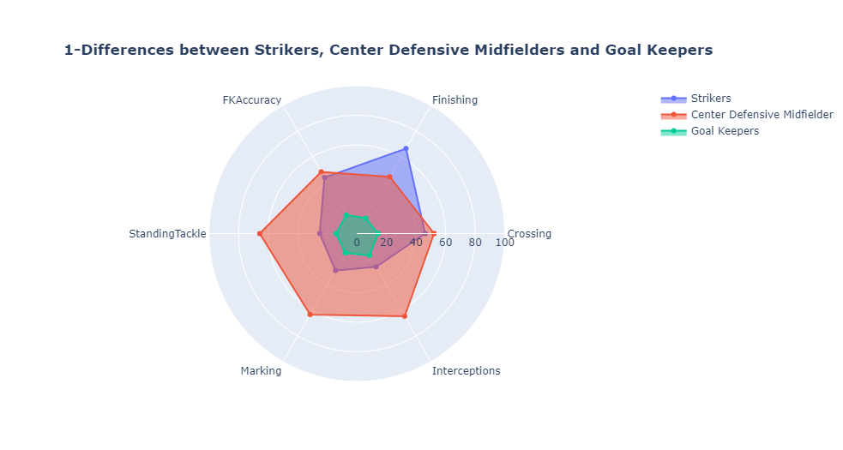
Polar Chart Visualization-1: Main Differences ‘ST’, ‘CDM’ and ‘GK’ Players
Polar Chart shows that Strikers are far better at Finishing compared to other players. The Center Defensive Midfielders are better at Tackling, Marking and Interceptions and goalkeepers are not involved in field activities who have low scores in these attributes.

Slide 24
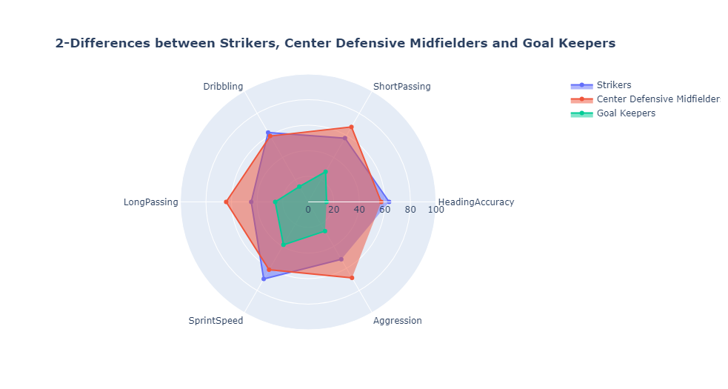
Polar Chart Visualization-2: Main Differences ‘ST’, ‘CDM’ and ‘GK’ Players
Polar Chart shows that Strikers are slightly better at Heading Accuracy, Sprint Speed, Dribbling. The Center Defensive Midfielders are better at Short Passing, Aggression and Long Passing and Goalkeepers are not involved in field activities who have low scores in these attributes.

Slide 25
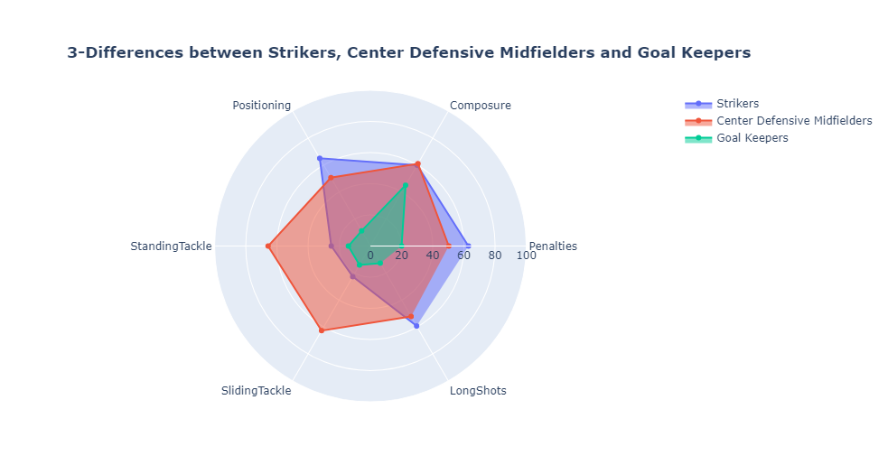
Polar Chart Visualization-3: Main Differences ‘ST’, ‘CDM’ and ‘GK’ Players
Polar Chart shows that Strikers are better at Long Shots, Penalties and Positioning. The Center Defensive Midfielders are better at Standing Tackle and Sliding Tackle among these 6 attributes. The Goal keepers have no roles such as tackling and positioning, hence the values are less compared with other attributes.

Slide 26
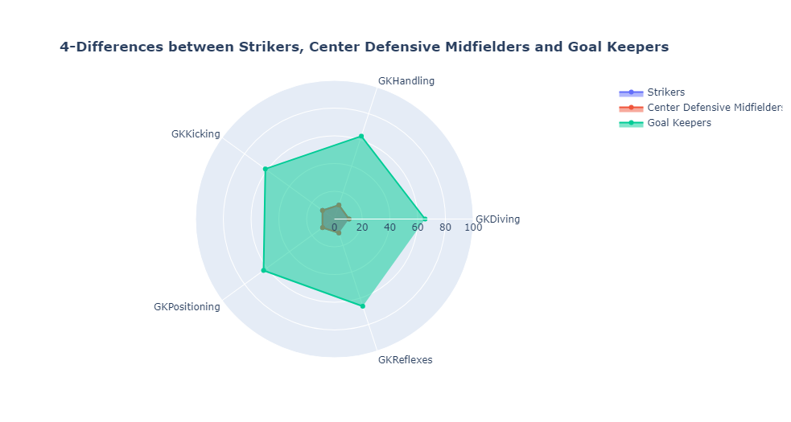
Polar Chart Visualization-4: Main Differences ‘ST’, ‘CDM’ and ‘GK’ Players
Polar Chart shows that Goal Keepers are far better at goalkeeping activities like GKKicking, GKHandling, GKReflexes etc. The Center Defensive Midfielders and Strikers both have almost similar and low scores in these attributes.

Slide 27
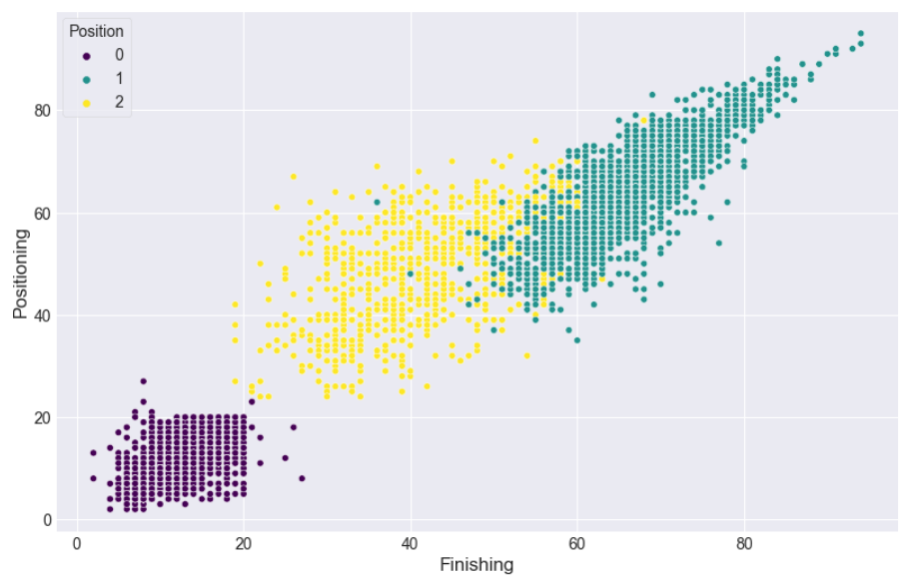
Scatterplot Visualization: Finishing vs Positioning among Strikers, Center Defensive Midfielders and Goal Keepers
The below scatterplot clearly shows the differences between each of the chosen players as we can easily conclude that strikers are better in these two attributes of finishing and positioning followed by center defensive midfielders and finally by goal keepers who have low scores in these attributes.

Slide 28
Conclusion of the analysis of selected player’s positions and skillsets
The largest number of players by position are ‘Strikers’ followed by ‘Goal Keepers’.
The largest number of players by zone are ‘Midfielders’ followed by ‘Defenders’.
Strikers are better at Positioning, Finishing, Penalties, Long Shots and so on.
Centre Defensive Midfielders are better at Tackling, Interceptions, Marking, Aggression and so on.
Goal Keepers are better at goal keeping activities such as ‘GKKicking’, ‘GKReflexes’ and so on.

Slide 29
Analysis of Strikers
3

Slide 30
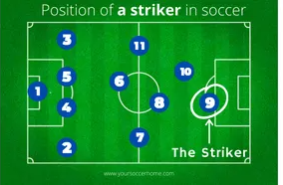
The most crucial position in football.
Strikers are the players closest to the opposing team’s goal.
Strikers are the most responsible people for scoring goals.
Strikers are generally tall and heavy , also have good vision, speed and strength.

Slide 31

How can Strikers be distinguished ?
To different types of players among Strikers can be identified by clustering them.
K-Means clustering algorithm has been used to cluster the Strikers with similar properties.
Features Considered :
Height
Weight
ST-Score(score obtained from ‘ST’ without bonus points)
Strength
Stamina

Slide 32
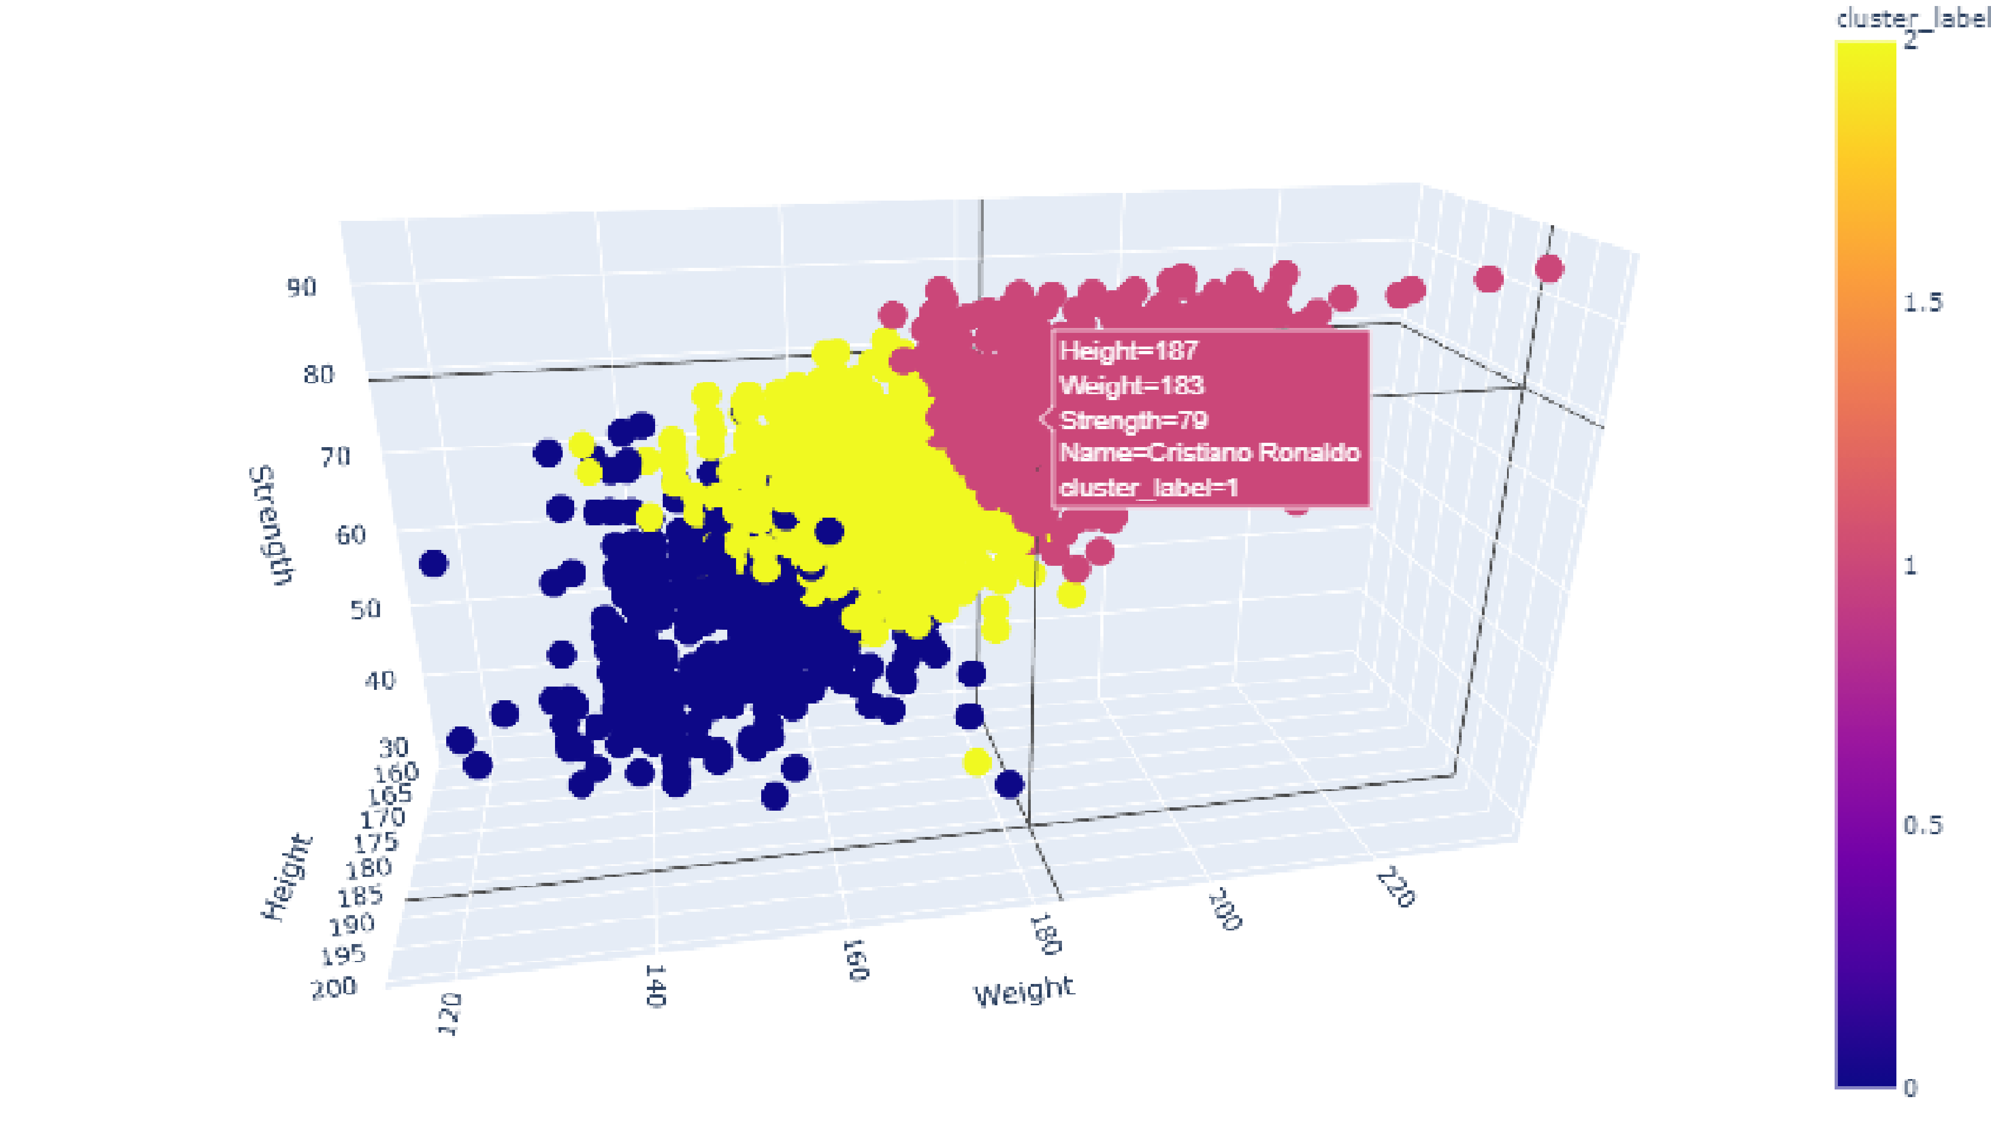
How can Strikers be distinguished ?
Clustering Results
Three distinguishing clusters of Strikers have been obtained.
Tall and strong strikers.
Comparatively short but strong strikers.
Short and fast strikers.

Slide 33
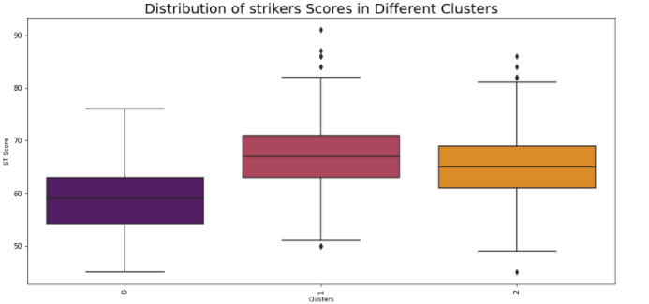
How can Strikers be distinguished ?
Analysis of Clusters
Cluster 1 contains strong players and hence have a good ST score.

Slide 34
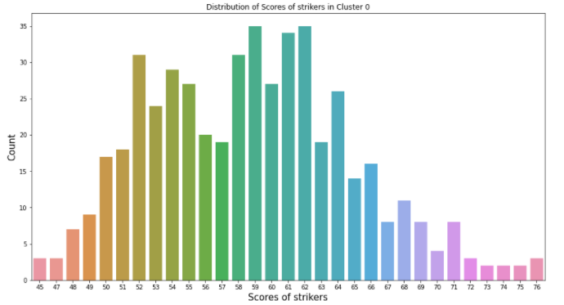
How can Strikers be distinguished ?
Cluster - 0
Short players , most of them below 177 centimeters.
Most of the players weigh less than 157 lbs.
Comparatively weaker players with ‘ST-Scores’ between 45 and 65.
Players in this cluster have 3* or 4* international ratings.
Examples : Javier Hernández , Rubén Castro

Slide 35
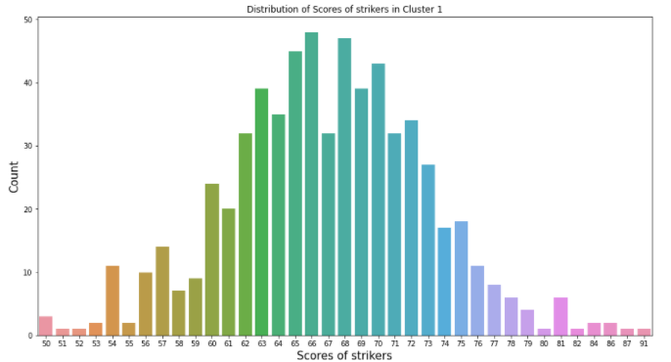
How can Strikers be distinguished ?
Cluster - 1
Tall players ,most of them are above 180 centimeters.
Heavy players ,most of them weighing between 170 and 200 lbs.
Very Strong players with ‘ST-Scores’ between 60 and 80.
Players in this cluster have 5* international ratings.
Examples : Cristiano Ronaldo , Robert Lewandowski

Slide 36
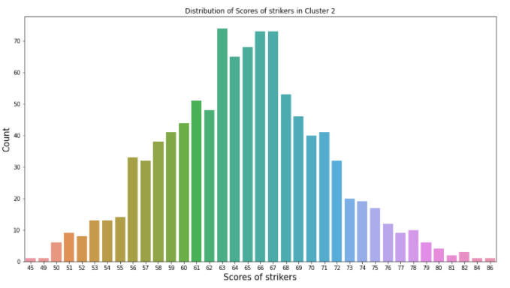
How can Strikers be distinguished ?
Cluster – 2
Comparatively short players, most of them are below 180 centimeters.
Most of them weighing between 150 and 170 lbs.
Strong players with ‘ST-Scores’ greater than 60.
Players in this cluster have 4* international ratings.
Examples :Sergio Agüero , Mauro Icardi.

Slide 37
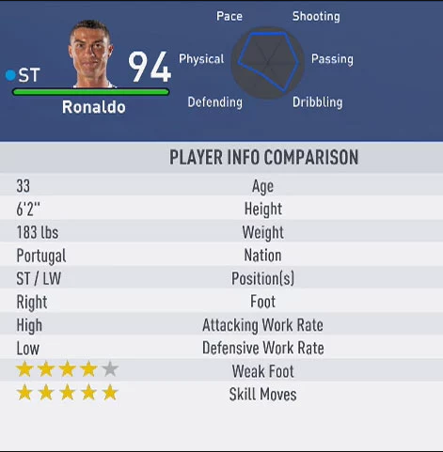
Conclusion on the analysis of strikers
“Tall and strong” ,”Mediocre(height/weight) and strong” and ”Short and fast” are the common clusters observed among Strikers in football.
Cristiano Ronaldo has been rated as the best striker with a score of 94 for FIFA-19.
Currently , Robert Lewandowski is the best striker in the world.
https://realsport101.com/fifa/fifa-19-career-mode-best-strikers-st-cf/
Digital Tools for Strategic Planning (DOORSTEP) | July 7, 2021

Slide 38
Thank you for your Attention

